Slide 1
Politician Punch Analysis

Slide 2

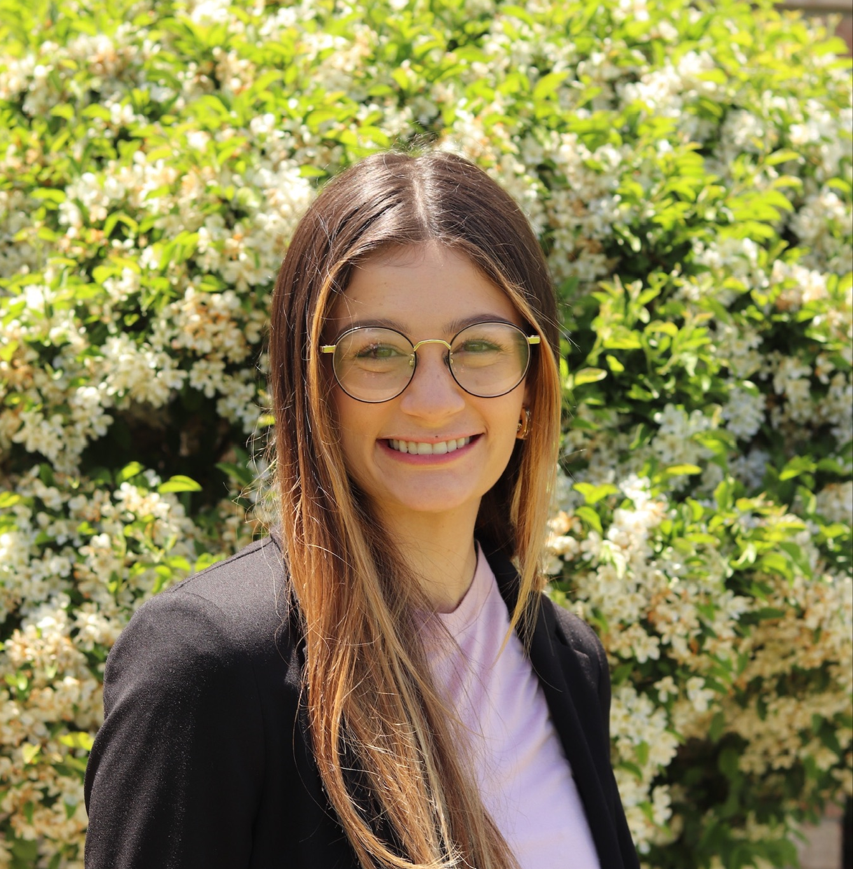
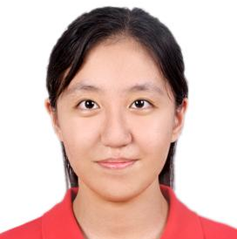

MEET THE TEAM
Jack Sayre
Emily Frost
Jiayu Chen
Zhiyue Chen
Data Analytics
sayre.203@osu.edu
Data Analytics
frost.310@osu.edu
Accounting
chen.10378@osu.edu
Finance
chen.9133@osu.edu

Slide 3
PROJECT DESCRIPTION
Our project is a social media focused study that aggregates data on various US Congressional members and compares those numbers to the number of votes each congressperson received.
The objective of the study is to determine which members of Congress are “heavy hitters” (significant online presence) versus those who may not have online presence at all, and comparing those categories to each person’s votes.
We will analyze data from October 2022, gather as many metrics as possible, and compare distributions after applying them to Congressional members.

Slide 4
RESULTS TO DATE - Our Process
Collect and clean data on Congress demographics
Sign up for Twitter API
1
2
3
4
Collect and clean data on Congress Twitter usernames
Scrape Twitter data

Slide 5
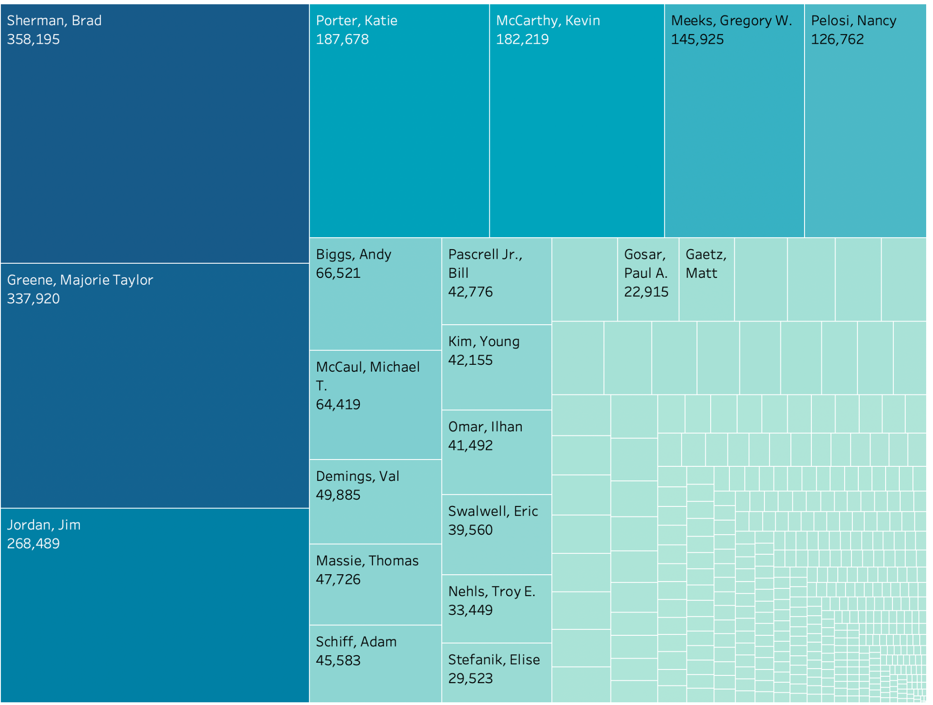
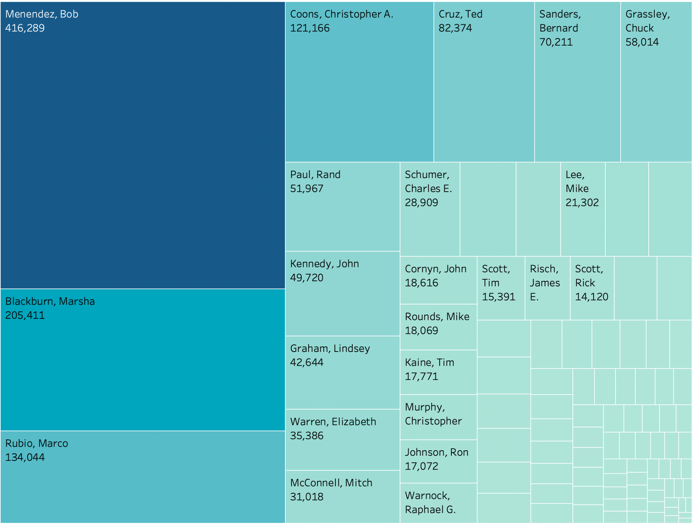
RESULTS TO DATE - Average Twitter mentions
House of Representatives
Senate
Notes:
Left one is the average twitter mentions of house representatives of each party in each state
Right one is the average twitter mentions of house representatives of each party in each state

Slide 6
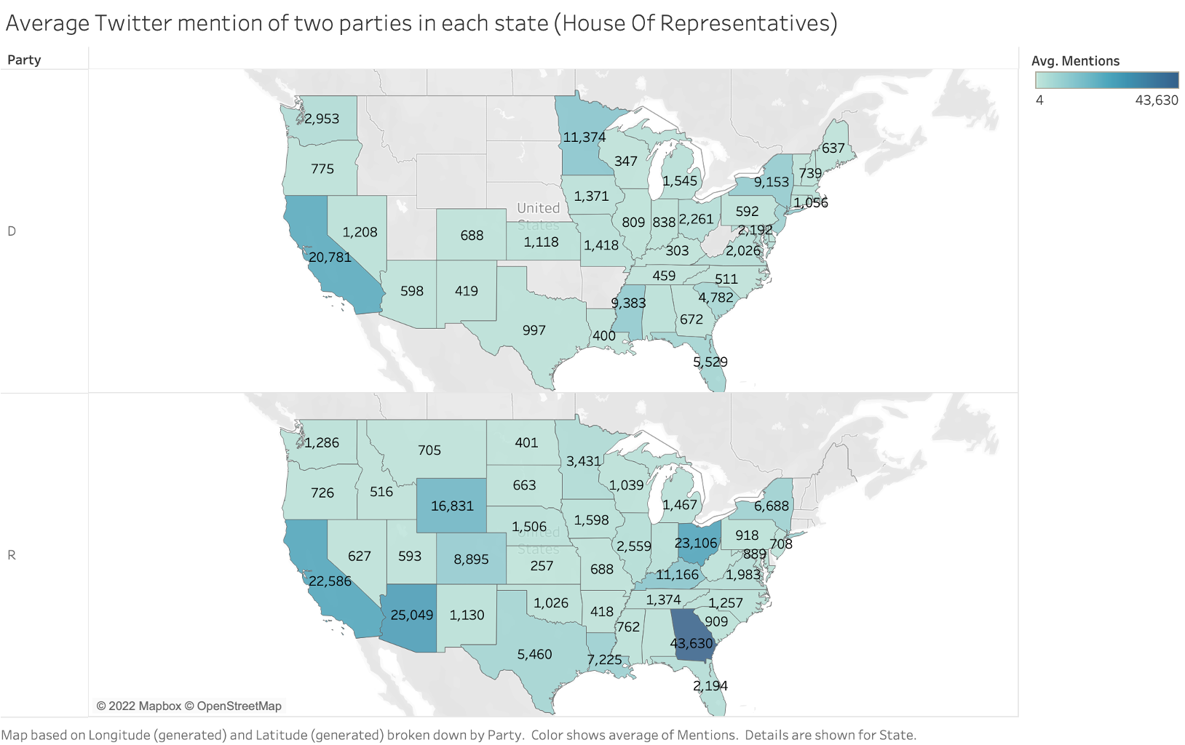
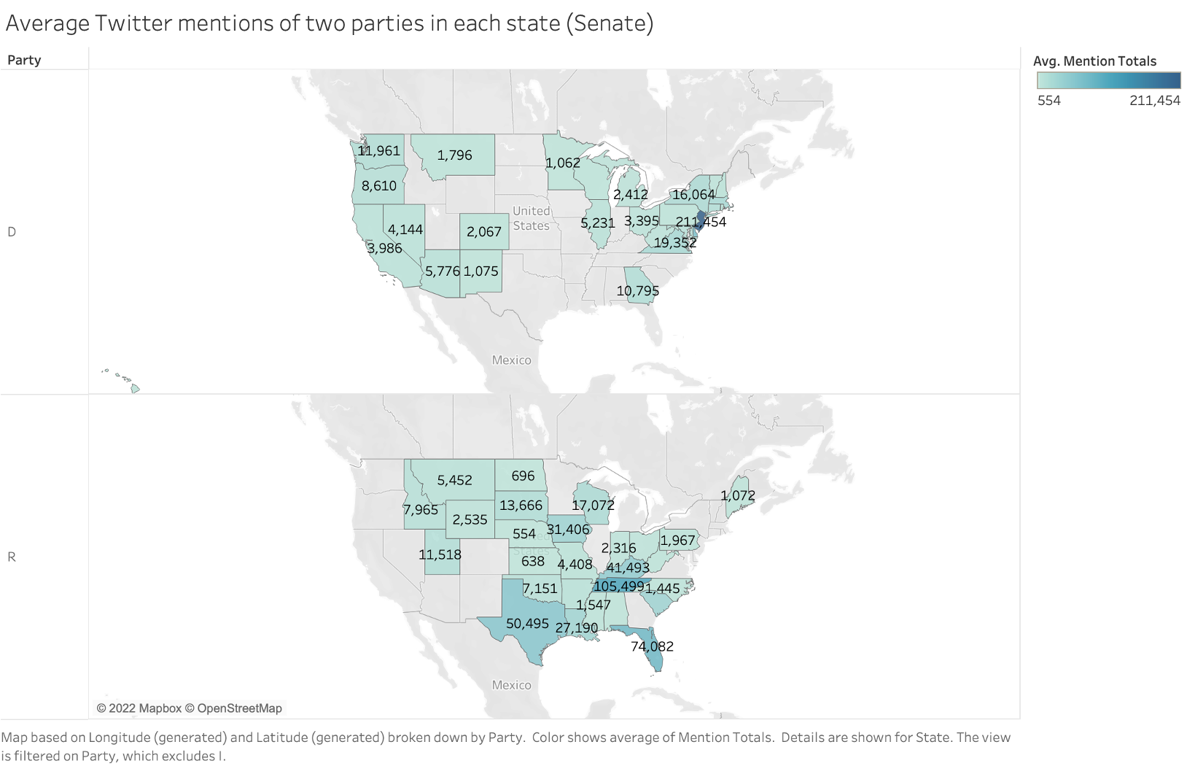
RESULTS TO DATE - Average Twitter mentions
House of Representatives:
Republicans have more mentions than Democrats.
Republicans have much more mentions than Democrats in south and midwest.
Senate:
More mentions of Democrats in west and east area
More mentions of Republicans in the mid of United States
Democrat
Democrat
Republican
Republican
Notes:
Left one is the average twitter mentions of house representatives of each party in each state
Right one is the average twitter mentions of house representatives of each party in each state

Slide 7
INSIGHTS
Obtaining elevated access to the Twitter API would allow for a larger time period to be looked at and allow for larger endpoint connections to the API, gaining further beneficial statistics
If we could find the positive and negative feedback from the public to each member’s Tweets, we may see a further and more accurate connection between vote and online presence because the amount of mentions does not always from the supporters.
Resources for tweet sentiment collection can be found here.

Slide 8
WHAT’S NEXT?
Collect data
Clean data
Perform Analysis
Present Findings
If necessary, collect remaining data for followers, retweets, and likes.
Clean and join data from politician demographics with new Twitter data.
- How do politicians with the most mentions compare to politicians with least mentions?
- What correlation is there between votes and number of mentions?
- How many people are represented per vote?
Compile data into final presentation

Slide 9
RESOURCES
Congress Demographic Data
Home - Congressional Twitter Accounts - LibGuides at University of California San Diego
117th Congressional Members Guide with Election Results and Demographic Data
Python Resources
Twitter API Documentation | Docs | Twitter Developer Platform
Tweepy Documentation — tweepy 4.11.0 documentation
pandas documentation — pandas 1.5.1 documentation (pydata.org)

